Slide 1
Recall System Analysis
Group No.: 05
Surbhi Patel
Richa Patel
Dharmik Patel
Raj Bhalodwala

Slide 2
AGENDA
Introduction​
About the Dataset
​Business Objectives
Methodology
Evaluation
References​

Slide 3
Introduction
A product recall is referred to as a request to return, exchange, or replace a product if a manufacturer or consumer protection organization finds flaws that might impair performance, endanger customers, or result in legal problems for the manufacturers. Products that are dangerous or have manufacturing flaws are frequently put on store shelves and sold to customers.
We created a clear Analytical Problem of our project, which is ‘To identify and analyze the reasons for product recalls in the food, medical devices, and other consumer goods industries and evaluate the effectiveness of the recall processes in ensuring public safety.

Slide 4
About the dataset
This dataset is for recall-system prediction from the U.S. Food and drug administration website. This is the latest data which has an information about different product type such as Biologics, Devices, Drugs, Food/Cosmetics, Tobacco, Veterinary and their status with the reason of why they are recalled from the specific state.
Data Quality:
Data itself is clear as it does not have any missing values and we can easily see from the heat map that there are not too many co-relation between the attributes.
Data Fitness:
The FDA is responsible for caring the community health by ensuring the safety, efficacy, and safety of human and veterinary drugs, biological products, and medical devices. The dataset provides information on product recalls initiated by companies and manufacturers that are regulated by the FDA.
Link of Dataset:
https://datadashboard.fda.gov/ora/cd/recalls.htm

Slide 5
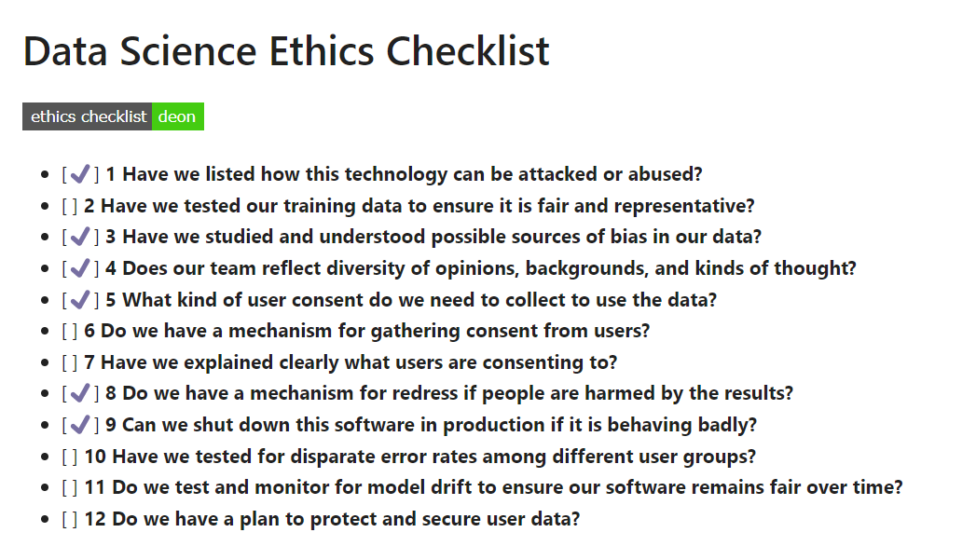
Ethical Assessment

Slide 6
Problem Statement
The problem statement is to identify and analyze the reasons for product recalls in the food, medical devices, and other consumer goods industries and evaluate the effectiveness of the recall processes in ensuring public safety. The goal is to identify patterns and trends in recall data to inform regulatory and industry efforts to prevent future recalls and improve the overall safety of consumer products.

Slide 7
Methodology
• Data Collection
• Data Cleaning (Excel, Python)
• Data Visualization (Tableau, Python, Excel)
• Exploratory Data Analysis (Python)
• Creating dashboard (Tableau)
• Build and apply suitable algorithms(Python)

Slide 8
Data Cleaning
Dataset itself is very clean and clear but there are couple of missing value that should be removed. Some columns are not important so it was deleted, because we didn’t get any output from this columns.
All the columns have categorical values so, it can be transferred to numerical by using different technics

Slide 9
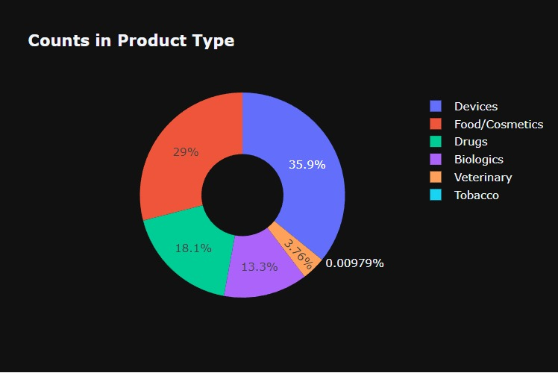
Data Visualization

Slide 10
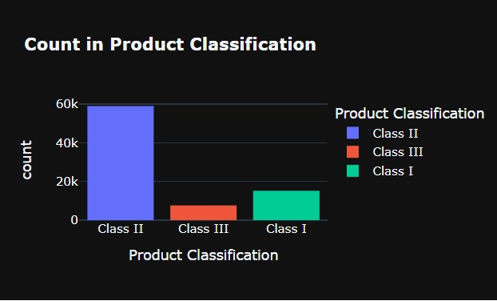

Slide 11
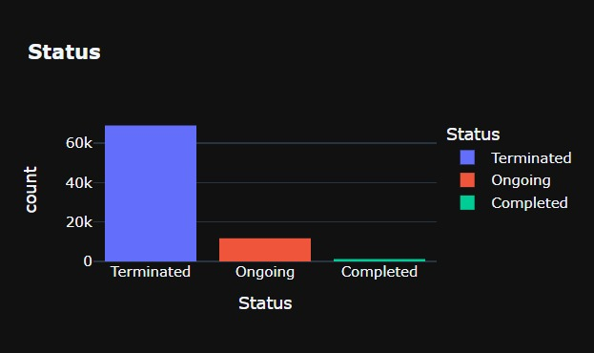

Slide 12
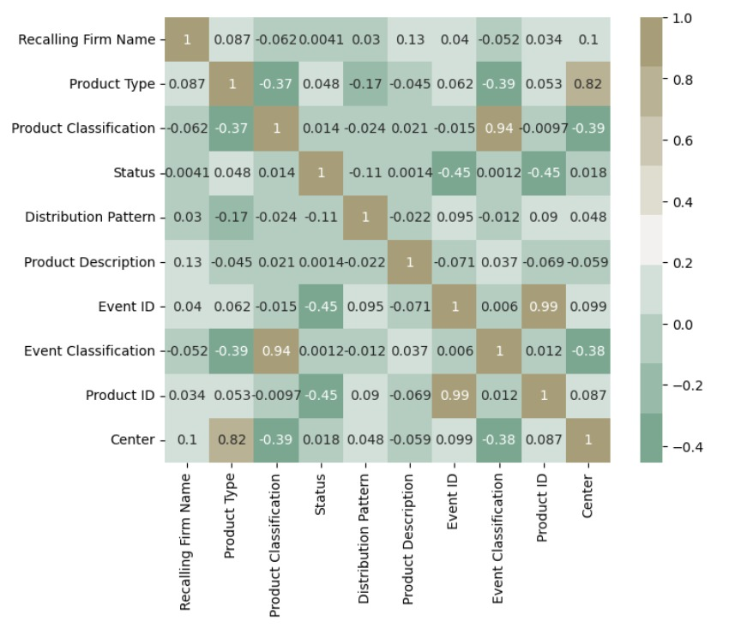

Slide 13
Summary of current findings
From the Graph we can conclude that we have more data regarding Devices, Food/Cosmetics and Drugs.
According to Product Classification we can say that we have intermediate risk to recall all Product Types, As more and less risker product types are seen in the minor products.
As we can see from the status column, most of the products are Terminated. Only some products have On-going and Complete status.
As we can see from the HeatMap there is not too much co-relation between attributes.

Slide 14
Next steps
We Will use Tableau to find insights from the data. Some of them are listed below.
We will use Tokenization for reason column and tried to convert it into numerical. Also we have decided to do sentiment analysis. For that, we will use RNN and now we will take status column as a target variable and will try to create a different model and will find which model gives a best result.

Slide 15
THANK YOU

